Slide 1
MasterPiets (A Piet IDE)
Gabrielle Singh Cadieux
Toronto Hack && Tell: Round 16 March 6th, 2018

Slide 2
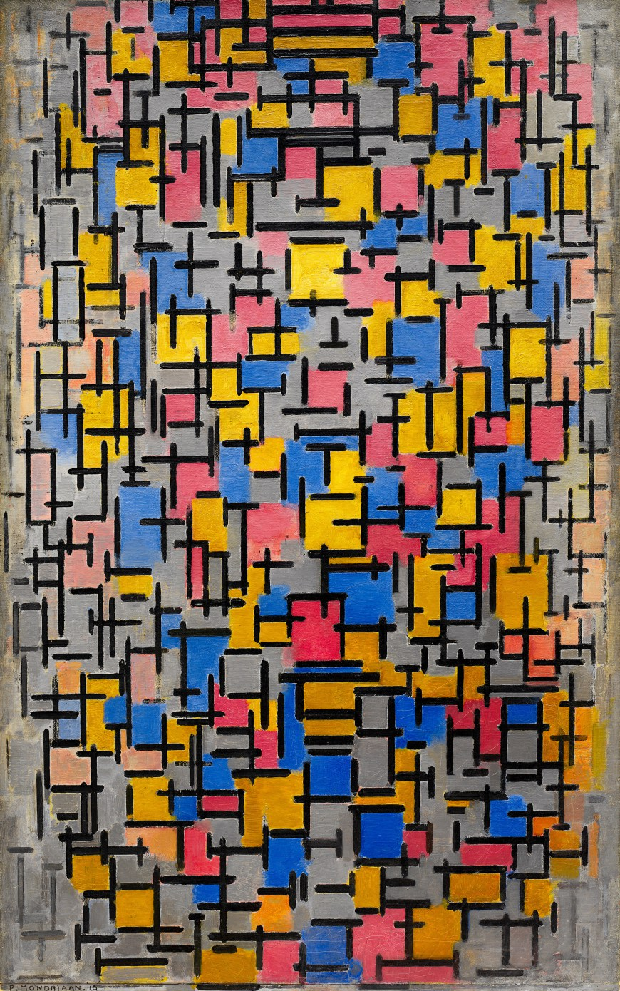
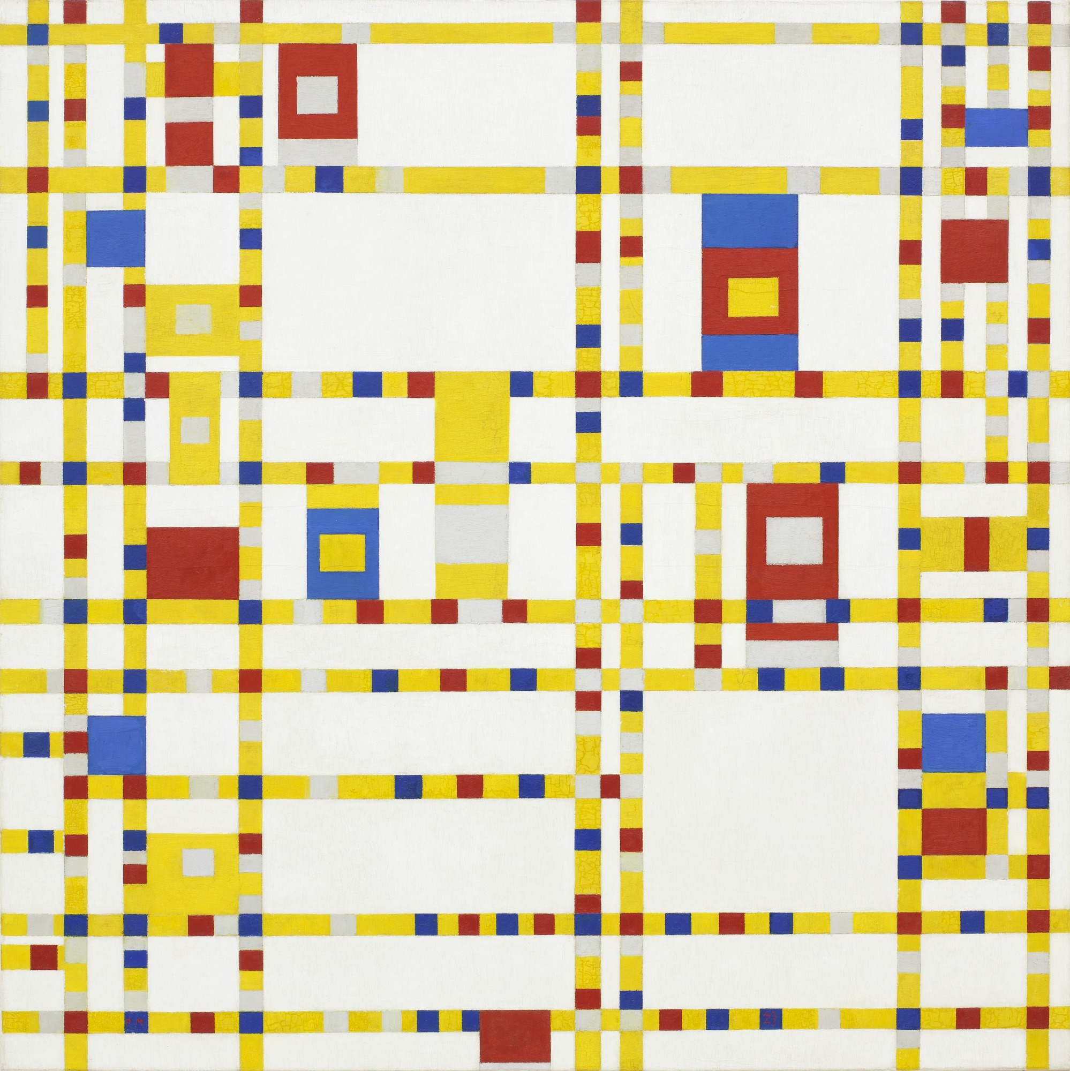
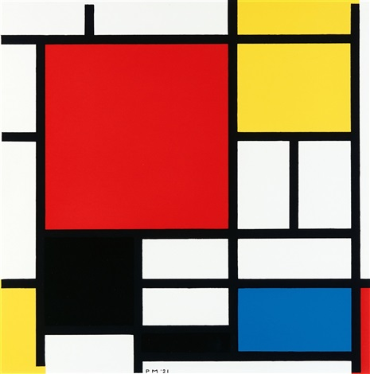
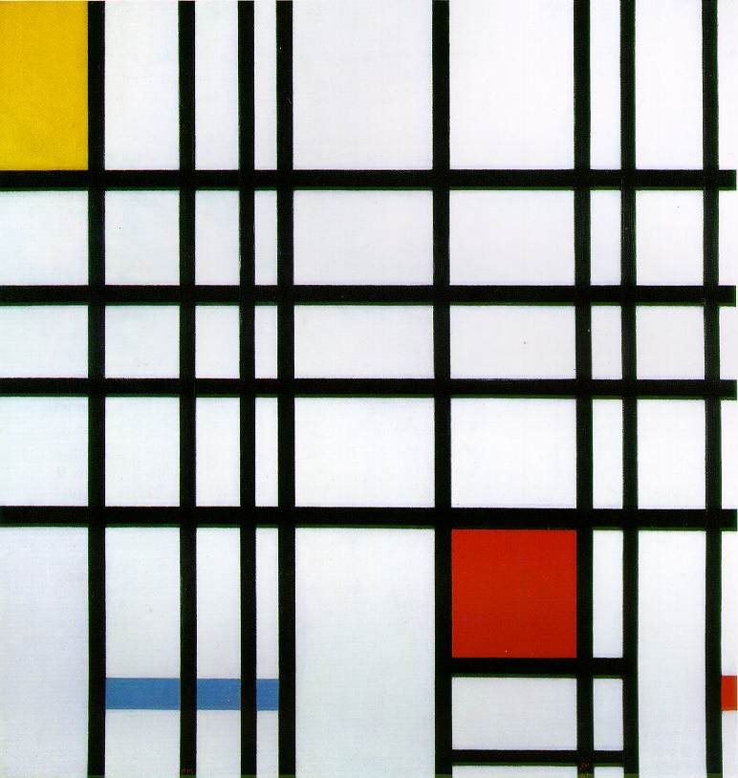
Works by Piet Mondrian

Slide 3
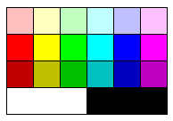
 |  | Lightness change
 |  | None | 1 darker | 2 darker
Hue change | None |  | PUSH | POP
 | 1 step | ADD | SUB | MUL
 | 2 steps | DIV | MOD | NOT
 | 3 steps | > | POINTER | SWITCH
 | 4 steps | DUP | ROLL | IN(num)
 | 5 steps | IN(char) | OUT(num) | OUT(char)
Piet palette
Piet instruction set

Slide 4
 |  | Lightness change
 |  | None | 1 darker | 2 darker
Hue change | None |  | PUSH | POP
 | 1 step | ADD | SUB | MUL
 | 2 steps | DIV | MOD | NOT
 | 3 steps | > | POINTER | SWITCH
 | 4 steps | DUP | ROLL | IN(num)
 | 5 steps | IN(char) | OUT(num) | OUT(char)

Slide 5
 |  | Lightness change
 |  | None | 1 darker | 2 darker
Hue change | None |  | PUSH | POP
 | 1 step | ADD | SUB | MUL
 | 2 steps | DIV | MOD | NOT
 | 3 steps | > | POINTER | SWITCH
 | 4 steps | DUP | ROLL | IN(num)
 | 5 steps | IN(char) | OUT(num) | OUT(char)

Slide 6
 |  | Lightness change
 |  | None | 1 darker | 2 darker
Hue change | None |  | PUSH | POP
 | 1 step | ADD | SUB | MUL
 | 2 steps | DIV | MOD | NOT
 | 3 steps | > | POINTER | SWITCH
 | 4 steps | DUP | ROLL | IN(num)
 | 5 steps | IN(char) | OUT(num) | OUT(char)

Slide 7
 |  | Lightness change
 |  | None | 1 darker | 2 darker
Hue change | None |  | PUSH | POP
 | 1 step | ADD | SUB | MUL
 | 2 steps | DIV | MOD | NOT
 | 3 steps | > | POINTER | SWITCH
 | 4 steps | DUP | ROLL | IN(num)
 | 5 steps | IN(char) | OUT(num) | OUT(char)

Slide 8

Hello World 1

Slide 9

Hello World 2

Slide 10

Hello World 3

Slide 11
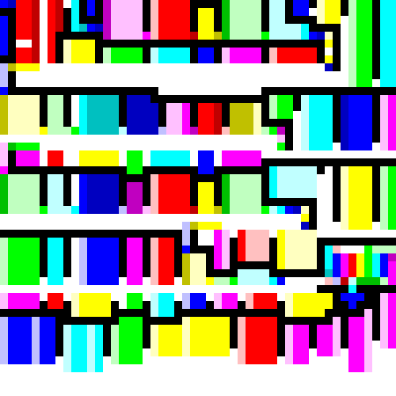
Hello World 4

Slide 12
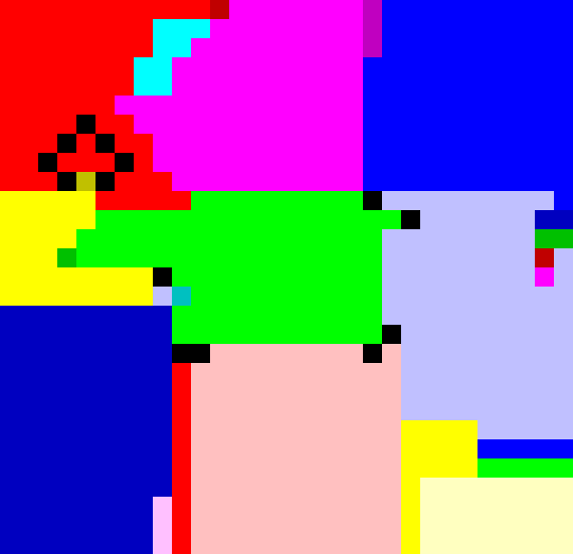
Hello World 5

Slide 13
 |  | Lightness change
 |  | None | 1 darker | 2 darker
Hue change | None |  | PUSH | POP
 | 1 step | ADD | SUB | MUL
 | 2 steps | DIV | MOD | NOT
 | 3 steps | > | POINTER | SWITCH
 | 4 steps | DUP | ROLL | IN(num)
 | 5 steps | IN(char) | OUT(num) | OUT(char)

Slide 14
 |  | Lightness change
 |  | None | 1 darker | 2 darker
Hue change | None |  | PUSH | POP
 | 1 step | ADD | SUB | MUL
 | 2 steps | DIV | MOD | NOT
 | 3 steps | > | POINTER | SWITCH
 | 4 steps | DUP | ROLL | IN(num)
 | 5 steps | IN(char) | OUT(num) | OUT(char)
PUSH 72

Slide 15
 |  | Lightness change
 |  | None | 1 darker | 2 darker
Hue change | None |  | PUSH | POP
 | 1 step | ADD | SUB | MUL
 | 2 steps | DIV | MOD | NOT
 | 3 steps | > | POINTER | SWITCH
 | 4 steps | DUP | ROLL | IN(num)
 | 5 steps | IN(char) | OUT(num) | OUT(char)
PUSH 72
OUT(char) → H

Slide 16
 |  | Lightness change
 |  | None | 1 darker | 2 darker
Hue change | None |  | PUSH | POP
 | 1 step | ADD | SUB | MUL
 | 2 steps | DIV | MOD | NOT
 | 3 steps | > | POINTER | SWITCH
 | 4 steps | DUP | ROLL | IN(num)
 | 5 steps | IN(char) | OUT(num) | OUT(char)
PUSH 72
OUT(char) → H
PUSH 101

Slide 17
 |  | Lightness change
 |  | None | 1 darker | 2 darker
Hue change | None |  | PUSH | POP
 | 1 step | ADD | SUB | MUL
 | 2 steps | DIV | MOD | NOT
 | 3 steps | > | POINTER | SWITCH
 | 4 steps | DUP | ROLL | IN(num)
 | 5 steps | IN(char) | OUT(num) | OUT(char)
PUSH 72
OUT(char) → H
PUSH 101
OUT(char) → e

Slide 18
 |  | Lightness change
 |  | None | 1 darker | 2 darker
Hue change | None |  | PUSH | POP
 | 1 step | ADD | SUB | MUL
 | 2 steps | DIV | MOD | NOT
 | 3 steps | > | POINTER | SWITCH
 | 4 steps | DUP | ROLL | IN(num)
 | 5 steps | IN(char) | OUT(num) | OUT(char)
PUSH 72
OUT(char) → H
PUSH 101
OUT(char) → e
PUSH 108

Slide 19
 |  | Lightness change
 |  | None | 1 darker | 2 darker
Hue change | None |  | PUSH | POP
 | 1 step | ADD | SUB | MUL
 | 2 steps | DIV | MOD | NOT
 | 3 steps | > | POINTER | SWITCH
 | 4 steps | DUP | ROLL | IN(num)
 | 5 steps | IN(char) | OUT(num) | OUT(char)
PUSH 72
OUT(char) → H
PUSH 101
OUT(char) → e
PUSH 108
DUP

Slide 20

Hello World 6

